Slide 1
Front-End Web Development Using React (Client Side Technologies - JavaScript)
Front-End Web Development Using React – JS
Eng. Reem Hassan Ahmed

Slide 2
JavaScript objects
Built-in objects
String
RegExp
Number
Math
Array
Date
Boolean
Error
Object

Slide 3
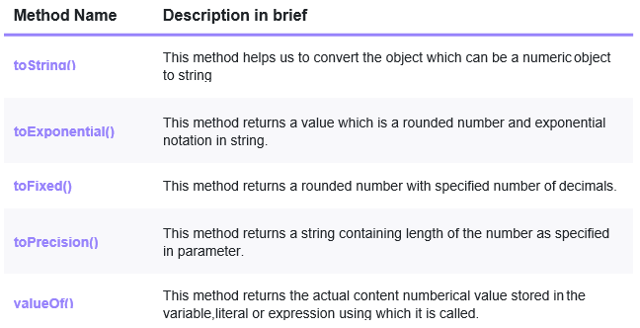
JavaScript objects Cont.
Number methods:

Slide 4
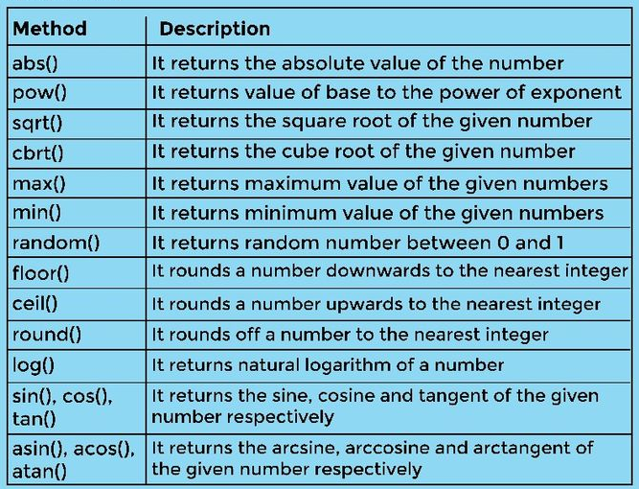
JavaScript objects Cont.
Math methods:

Slide 5
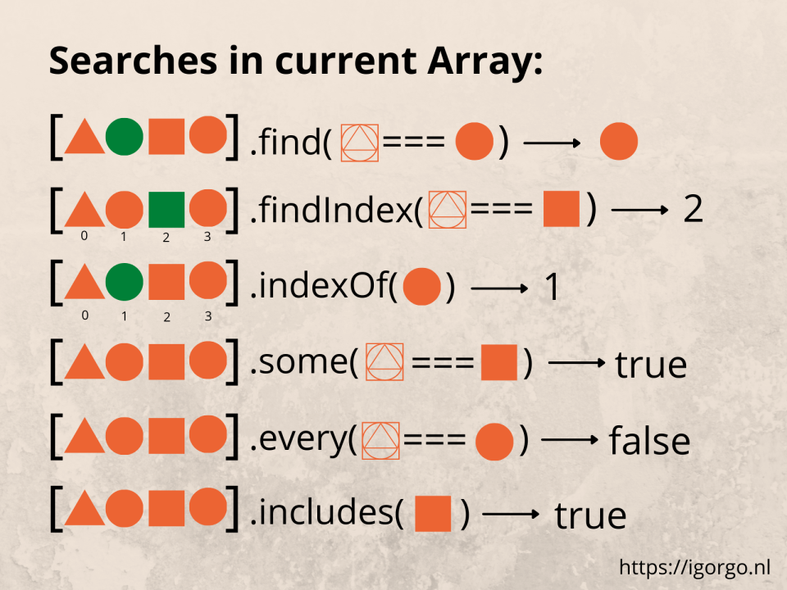
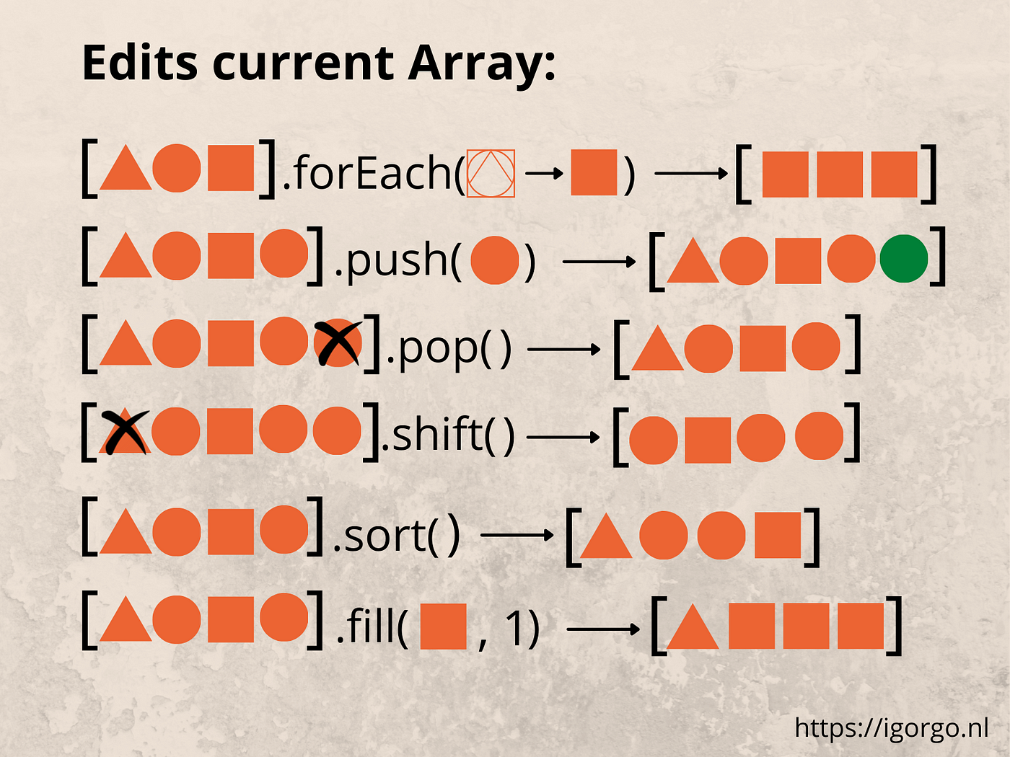
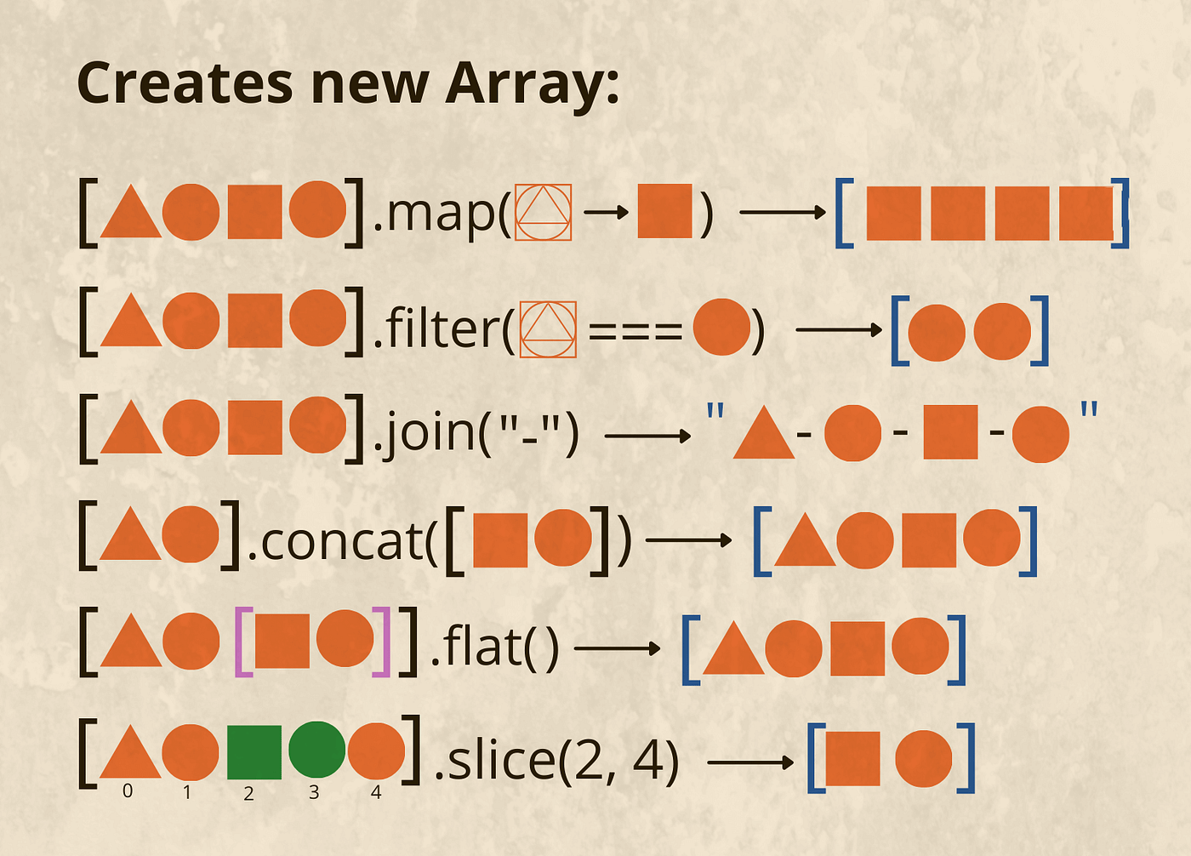
JavaScript objects Cont.
Array methods:

Slide 6
JavaScript objects Cont.
Associative array:
A special type of array that contains key-value pairs (not indexes)
Key of this array is always a string or a variable that holds string value, while the value can hold anything.
Normal array methods cannot be used on the associative array.
For loop cannot be used to loop on associative array, instead for-in loop is used.

Slide 7
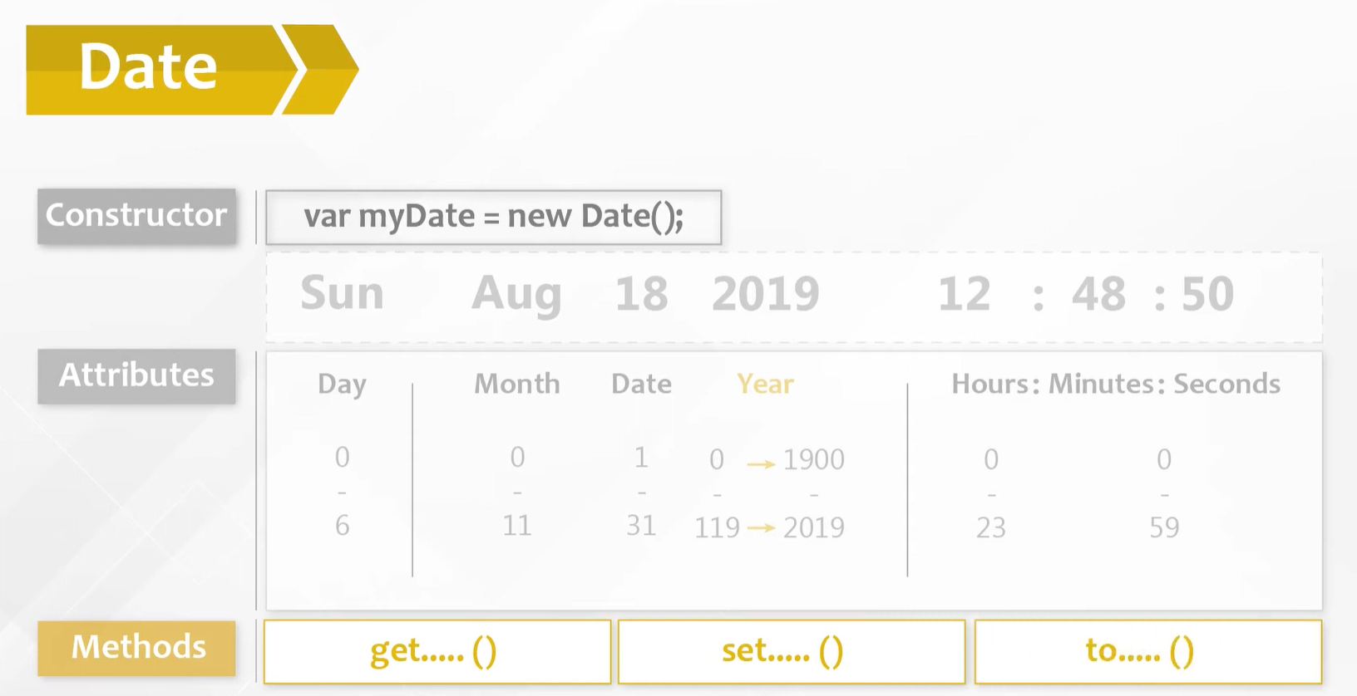
JavaScript objects Cont.
Date:

Slide 8
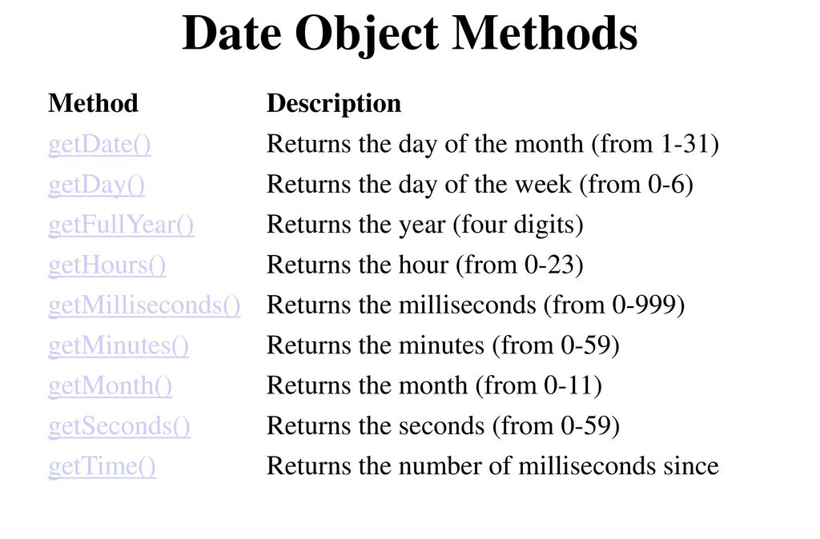
JavaScript objects Cont.
Date get methods:

Slide 9
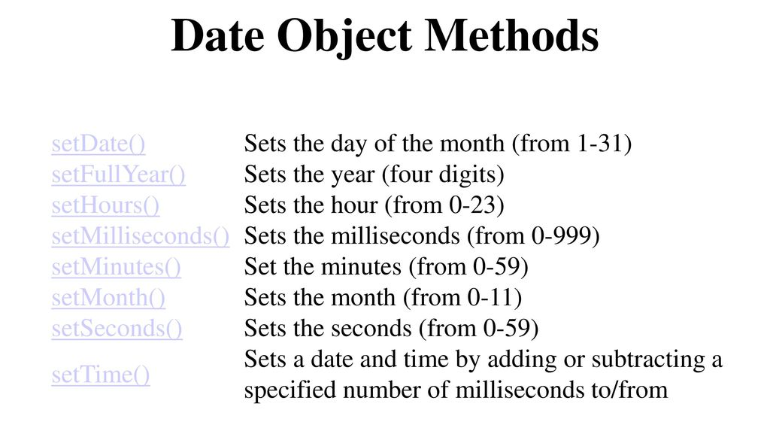
JavaScript objects Cont.
Date set methods:

Slide 10
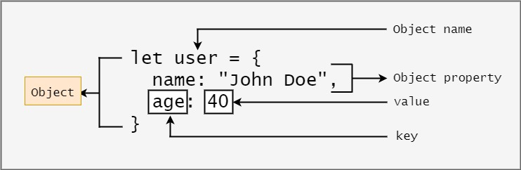
JavaScript objects Cont.
Object object:

Slide 11
06
DOM and BOM
Front-End Web Development Using React – CSS

Slide 12
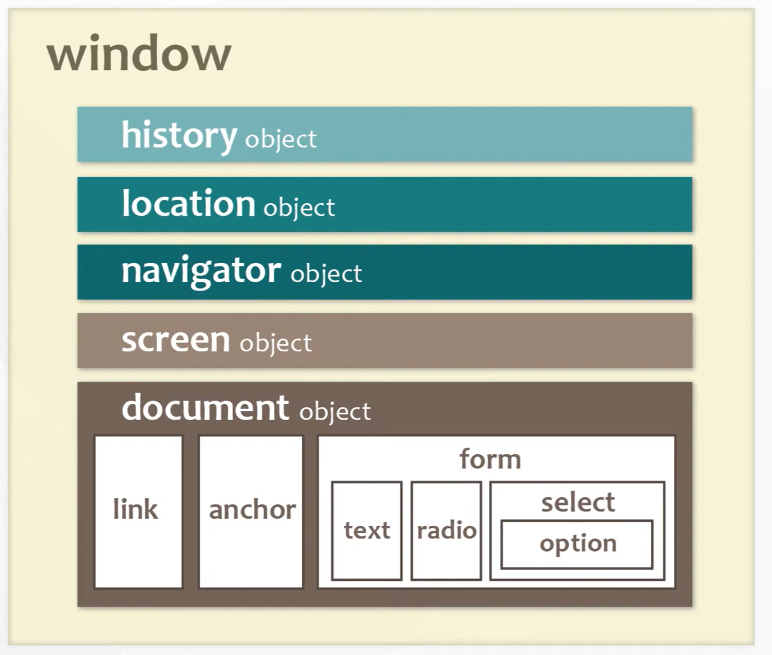
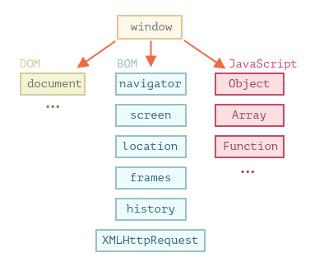
What is the difference between BOM and DOM?
BOM is every window child that is related to the browse, while DOM is the HTML document.
Window object is the parent for both DOM and BOM

Slide 13
Window object
5
1
2
3
Screen Object
Document Object
4
Location Object
Navigator Object
History Object

Slide 14
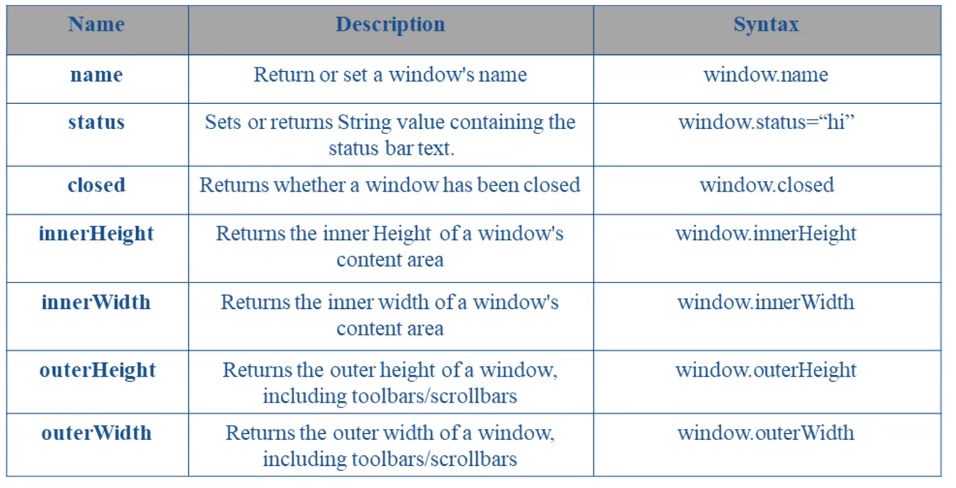
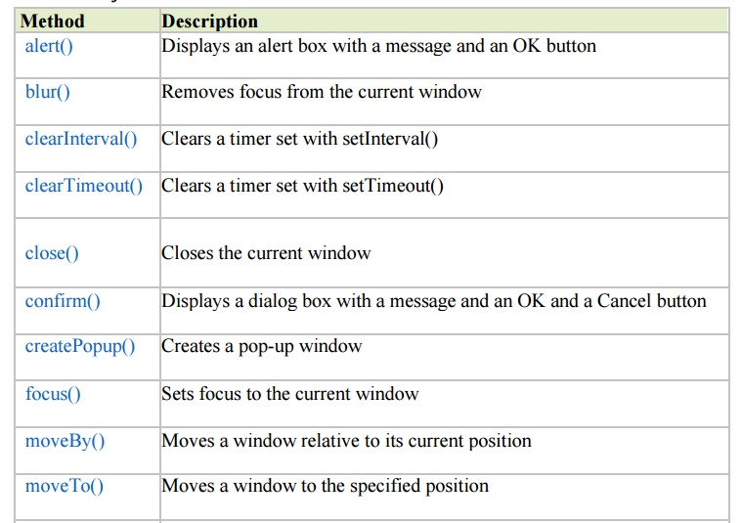
Window
Window methods and properties:

Slide 15
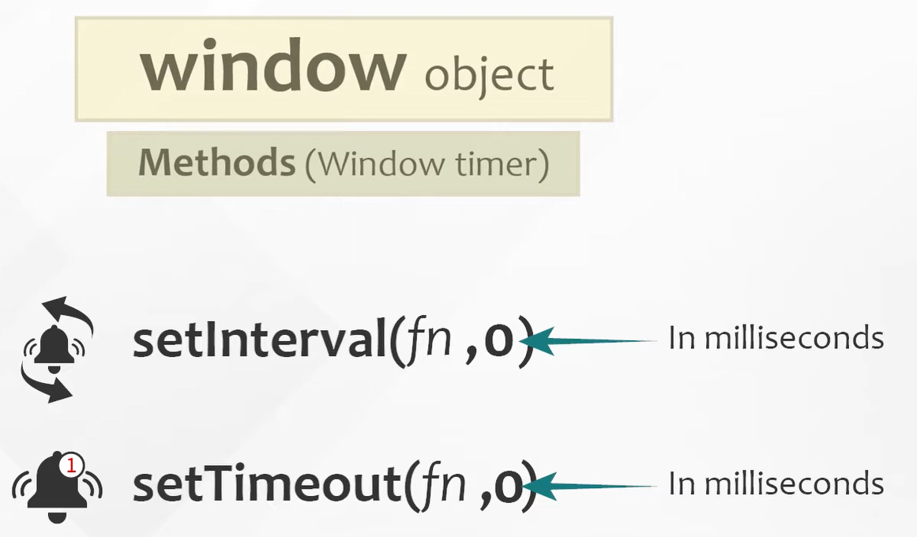
Window Cont.
SetInterval vs. SetTimeout

Slide 16
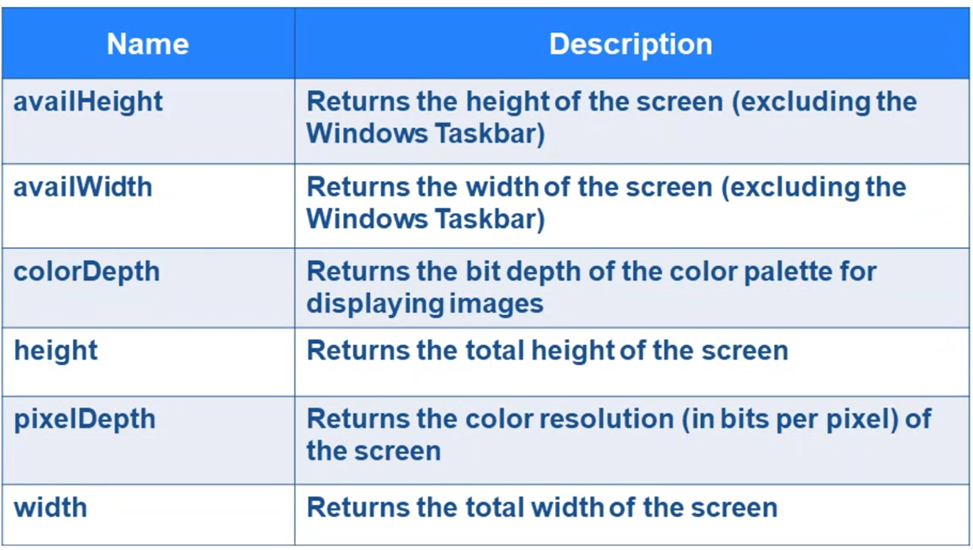
Screen
Screen object holds information about the desktop outside the browser.
Screen properties:

Slide 17
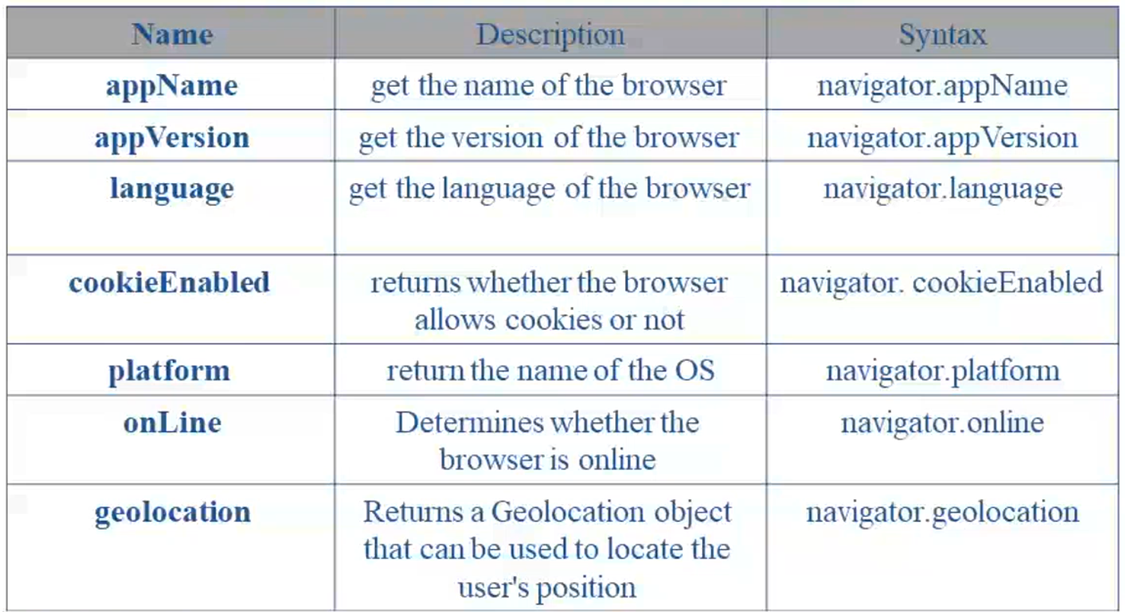
Navigator
Navigator object holds information about the browser.
Navigator properties:

Slide 18
History
History object holds an array of URLs related to the opened tab (NOT the whole browser).
History properties:
Length
History methods:
Back()
Forward()
Go()

Slide 19
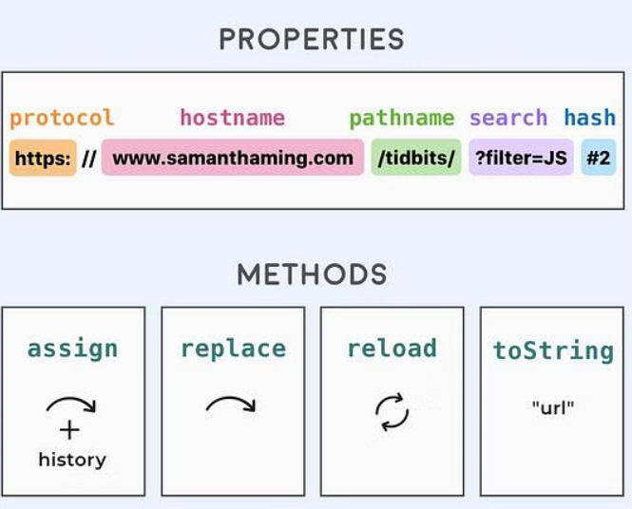
Location
Location object holds information about the current URL.
Location properties and methods:

Slide 20
Thanks!
Front-End Web Development Using React – CSS
Does anyone have any question?
ReemHassan160299@gmail.com
+201092427577

